Slide 1

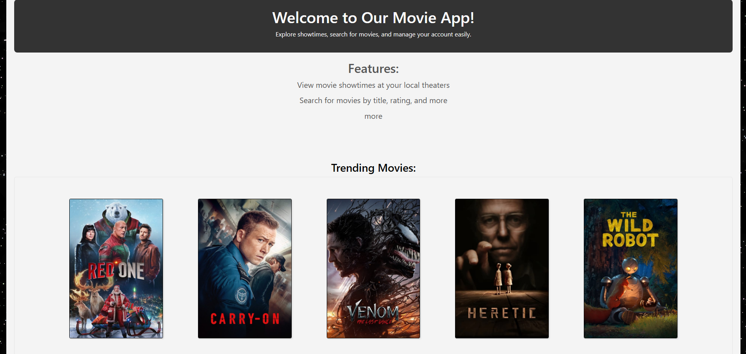
group 19 Movie app
Made by: Antti, Samuli, Topi, Ville

Slide 2
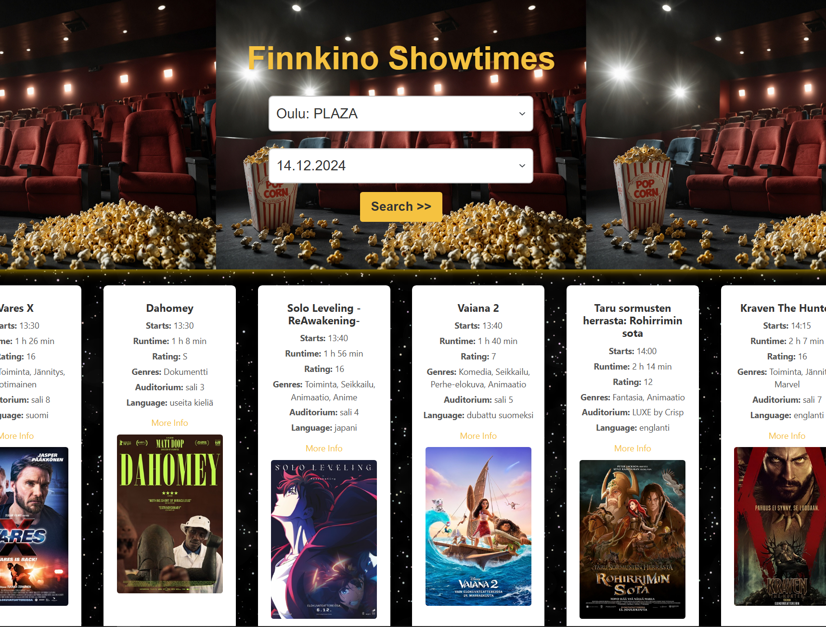
roles
All of us got to do both backend and frontend, but focusing on:
Antti: backend
Topi: backend
Samuli: frontend
Ville: frontend

Slide 3
Project phases
Firstly, we individually did the todo tasks
We followed moodle task plan on what to do every week
Basically we were on time every week
We held meetings on discord
Once a week we had project meeting with a teacher

Slide 4
What did We learn during the project?
Developing applications with react, node and postgresql
Automatic testing with jest and supertest
Project management (Scrum)

Slide 5
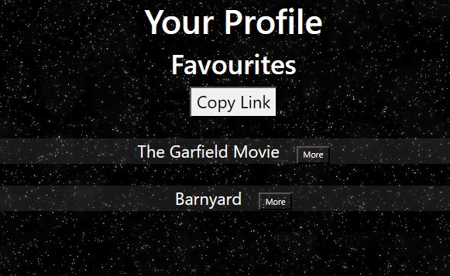
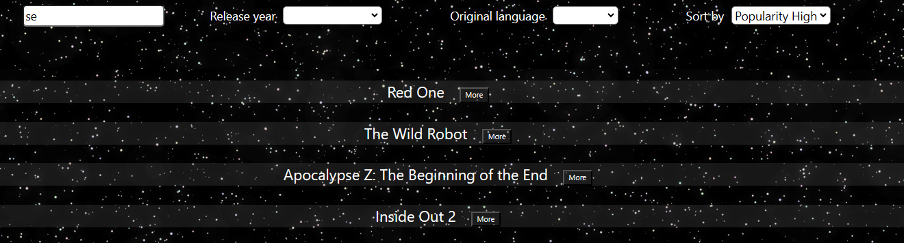
What was successful?
Teamwork makes the dream work
Project and time management
The lack of depression
The app itself

Slide 6
What challenges did We have ?
CSS styling was one of the biggest challenges...
Making the website responsive was also a bit challenging
Additionally, there were difficulties with merging branches at the beginning of the project

Slide 7
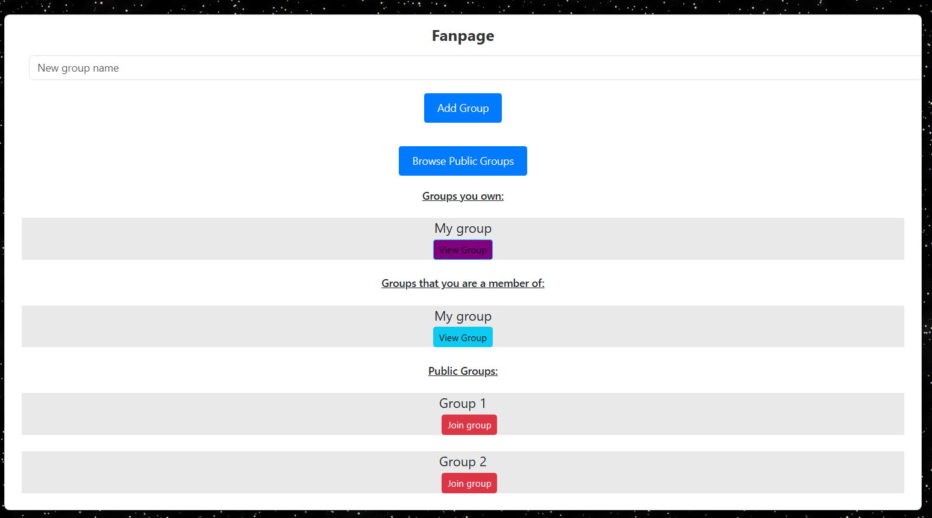
Conclusion
Other than css problems, the project went quite well. And we are satisfied with the result.
Overall, It was a fun project.
questions?

